Slide 1

Advanced JavaScript Debugging Techniques for Agile Teams
Zach Gardner
HTML5/JavaScript Consultant
Keyhole Software
zgardner@keyholesoftware.com
@zachagardner

Slide 2


































Titanium Sponsors
Platinum Sponsors
Gold Sponsors

Slide 3
Motivation
Successful Agile projects recognize the following:
Time = fuel
Developers write code and fix code

Slide 4
Validate Your Assumptions
The most fundamental principle behind debugging.
If you can list out your assumptions, you can effectively debug.

Slide 5
Format
A pattern will be presented with the following:
Case study
Formal name
Elevator pitch
Detailed description
Use cases
Pros and cons

Slide 6
Breakpoint On Specific Condition
function somethingImportant(fn, scope) {
My.library.fireEvent(‘EVENT_NAME’, fn, scope);
}
My.library.fireEvent = function (e, fn, scope) {
var listeners = this.listeners[e];
if (!listeners) {
return;
}
this.fireListeners(listeners, fn, scope);

Slide 7
Conditional Breakpoints
Only trigger a breakpoint when an internal or external expression evaluates to true.
Most languages and IDEs have the concept of a conditional breakpoint.
Breakpoints can be set in the execution environment or in the code through use of the debugger statement.

Slide 8
Conditional Breakpoints
function myFunction (x) {
var something = new Class();
if (x == 10) { debugger; }
something.doSomething(x);
}

Slide 9
Conditional Breakpoints
Allowing the code to define breakpoints is preferable because:
Breakpoints sync up with code changes.
Can manage breakpoints between browsers.
Ensures the flow is correct while determining the fix.
Helps remind developers to fix all bugs before committing.

Slide 10
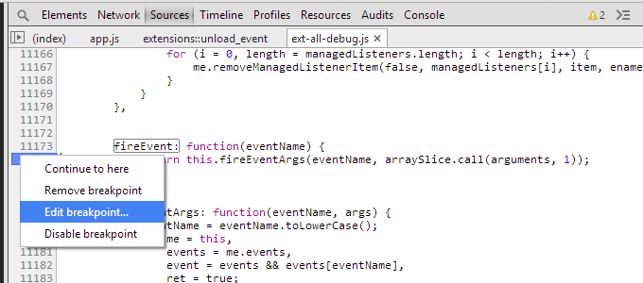
Conditional Breakpoints
Chrome and IE allow conditional breakpoints in Dev Tools:

Slide 11
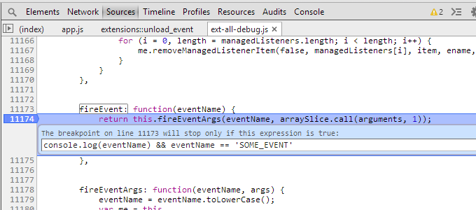
Conditional Breakpoints
When the expression evaluates to true, a breakpoint occurs:

Slide 12
Conditional Breakpoints
Some bugs only occur on the second or third time code is executed.
I have used conditional breakpoints to get those specific cases:
function shouldWork() {
window.ZG = (window.ZG ? window.ZG + 1 : 1);
if (window.ZG == 2) { debugger; }
doSomethingNormal();
}

Slide 13
Conditional Breakpoints
Best used when a well-defined condition triggers a bug.
Some developers may prevent the triggering condition rather than the root cause.
Not all bugs have well-defined triggers.

Slide 14
JavaScript Needs Private/Protected
function myClass() {
// Private
this.private = 123;
this.setPrivate = function (x) { this.private = x; }
return this;
}
var goodClass = new myClass();
goodClass.setPrivate(‘This is good’);
var badClass = new myClass();
badClass.private = ‘This is bad’;

Slide 15
Observing Object Changes
Chrome can observe changes in the properties of an object.
Public/private/protected may be well documented, but other sections of code may ignore the documentation.
This can cause errors to occur if getters and setters need to be called to ensure consistency of a class.
By hooking into the places where the object changes, Chrome allows the developer to see where the properties of an object are being modified.

Slide 16
Observing Object Changes
function myClass() {
var varToCheck = this.varToCheck;
this.__defineSetter__(‘varToCheck’, function (v) {
debugger; varToCheck = v; return varToCheck; });
this.__defineGetter__(‘varToCheck’, function () {
return varToCheck });
// Do normal stuff
}
var badClass = new myClass();
badClass.varToCheck = 5; // Executes the debugger

Slide 17
Observing Object Changes
Can quickly track down the problem in a large code base if getting or setting outside of the getter or setter is the cause.
The private variable may be several objects deep or the containing object may be redefined.
Tracking every getter can lead to noise.
Only works in Chrome.

Slide 18
Ever Debugged a Function Like This?
drawAxis: function(init) { var chart = this.chart, surface = chart.surface, bbox = chart.chartBBox, store = chart.getChartStore(), l = store.getCount(), centerX = bbox.x + (bbox.width / 2), centerY = bbox.y + (bbox.height / 2), rho = Math.min(bbox.width, bbox.height) /2, sprites = [], sprite, steps = this.steps, i, j, pi2 = Math.PI * 2, cos = Math.cos, sin = Math.sin; if (this.sprites && !chart.resizing) { this.drawLabel(); return; } if (!this.sprites) { //draw circles for (i = 1; i <= steps; i++) { sprite = surface.add({ type: 'circle', x: centerX, y: centerY, radius: Math.max(rho * i / steps, 0), stroke: '#ccc' }); sprite.setAttributes({ hidden: false }, true); sprites.push(sprite); }
for (i = 0; i < l; i++) { sprite = surface.add({ type: 'path', path: ['M', centerX, centerY, 'L', centerX + rho * cos(i / l * pi2), centerY + rho * sin(i / l * pi2), 'Z'], stroke: '#ccc' }); sprite.setAttributes({ hidden: false }, true); sprites.push(sprite); } } else { sprites = this.sprites; //draw circles for (i = 0; i < steps; i++) { sprites[i].setAttributes({ x: centerX, y: centerY, radius: Math.max(rho * (i + 1) / steps, 0), stroke: '#ccc' }, true); } //draw lines for (j = 0; j < l; j++) { sprites[i + j].setAttributes({ path: ['M', centerX, centerY, 'L', centerX + rho * cos(j / l * pi2), centerY + rho * sin(j / l * pi2), 'Z'], stroke: '#ccc' }, true); } } this.sprites = sprites; this.drawLabel();

Slide 19
Binary Search
Divide a function in two halves and see which half produces the bug.
By segmenting a problem into two halves, the scope can quickly be narrowed to focus in on the cause of the bug.
Once the offending segment is found, divide it into two halves.
The halves can be unequal, but it works best if they are close.

Slide 20
Binary Search
Works well when functions are very modular.
If written well, can isolate offending code quickly.
Best used when you have no idea where the cause of the bug is.
Can lead to false positives.
Does not guarantee results.
Can be time consuming if it is the only technique used.

Slide 21
Fn 1 calls Fn 2 calls Fn 3 calls...
function primaryFunction () {
// stuff
secondaryFunction();
// more stuff
}
function secondaryFunction () {
// stuff
tertiaryFunction();
}

Slide 22
Bottom-up
Observe the effect of calling a function until the bug is observed.
In Bottom-up debugging, start with putting a debugger statement in code that happens before the bug occurs.
Put a watch statement to check for the bug.
Step over a function and see if the watch statement indicates that the function just called triggered the bug.
If it did not, go to the next.
If it did, restart the process, then step into the function.

Slide 23
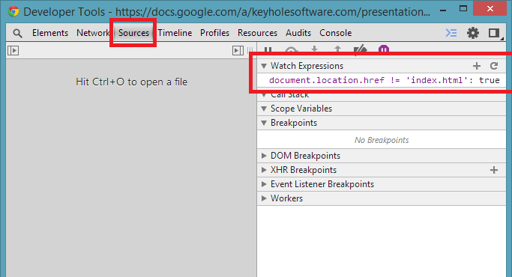
Bottom-up
When a button was clicked, some code was causing redirecting to the login page.
I listened for click and added a watch expression:

Slide 24
Bottom-up
Can quickly isolate bug if working code is known and if the bug can be easily identified.
Doesn’t necessarily lead to finding true source of bug.
May lead to laziness when debugging.
Takes a long time to identify, restart, step into, identify, etc.

Slide 25
Function Incorrectly Called
function throwAnExecption() {
// Throw an exception
}
function callsThrowAnException () {
throwAnException();
}
function somethingComplicated() {
callsThrowAnException();

Slide 26
Top-down
Find the cause of a bug when the symptom is well-defined.
If a bug can be easily observed, the root cause needs to be determined.
It may be calling a function outside of the normal flow or determining the source of incorrectly shown HTML.

Slide 27
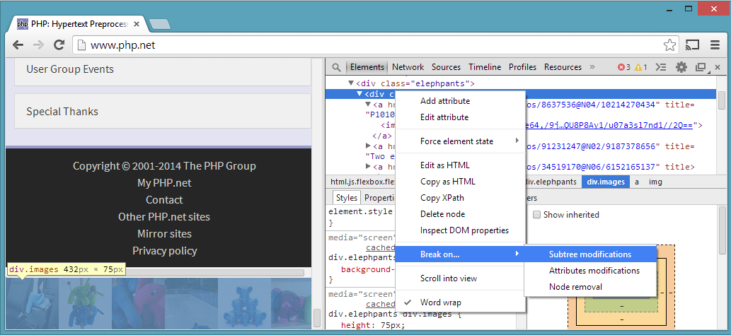
Top-down
Some widgets were rendering with a width and height of 0.
It was difficult to determine where width/height is calculated, so I observed when the DOM attributes were changed:

Slide 28
Top-down
Observing DOM changes is a quick way to see if the bug occurs.
Can also be done for exceptions or a throw in a try/catch.
There may be so many valid DOM changes that the breakpoint produces excessive noise.
Some bugs are very difficult to directly observe.

Slide 29
Not Obvious Issue
function onClick() {
alert(‘I was clicked!’);
}
function onRender(button) {
button.on(‘click’, onClick);
}

Slide 30
Event Listener Breakpoints
Observe how existing code responds to a DOM event.
Chrome’s Dev Tools allow a developer to select which events they care about.
When the event is executed, the developer can step through the calls to find why it is working differently than they think it should.

Slide 31
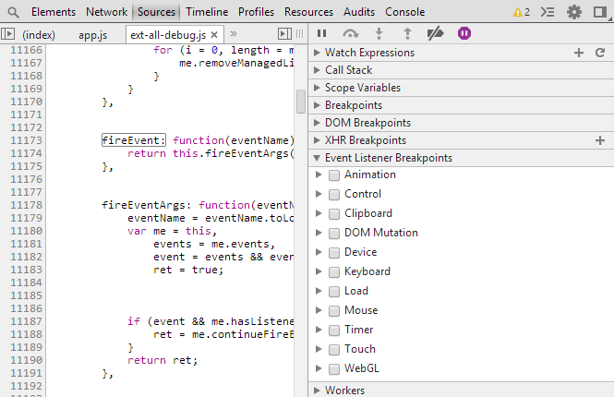
Event Listener Breakpoints
By stepping through the code on click, I can find where my assumptions fail:

Slide 32
Event Listener Breakpoints
When a well-defined condition is known, it is easy to set up an event listener breakpoint to find out exactly what is going on.
This method makes it easy to narrow the focus on a large code base.
This can lead to Heisenbugs and make it impossible to debug.
It can take a long time to find where an assumption is invalidated.

Slide 33
QA Best Practices
Always turn on debuggers before testing.
When filing a bug, include as much information as possible:
What steps did you take to see the error?
What browser were you in when the error happened?
Can you provide a screenshot of the error?
Did the error show up in the developer tools?
When you see a bug, repeat the process to make sure the exact steps can be determined.

Slide 34
Conclusion
JavaScript is the wild west of development.
What can go wrong will go wrong.
Developers need to understand effective debugging patterns:
Conditional Breakpoints
Observing Object Changes
Binary Search
Bottom-up
Top-down
Event Listener Breakpoints

Slide 35
Download The Presentation
Presentation materials available on the Keyhole GitHub:
bit.ly/keyholekcdc14
Other Keyhole Presentations Available:
Grunt 101
Java RESTful End Point Frameworks to Support the Shift to HTML5 SPA
JSF In The Modern Age
Stop by Keyhole Software’s booth to talk about career opportunities with my team & get entered to win an HP Chromebook 14.

